Slide 1
Model-Agnostic Interpretation of Learned Models for Genomic Sequences
Jennie Martin

Slide 2
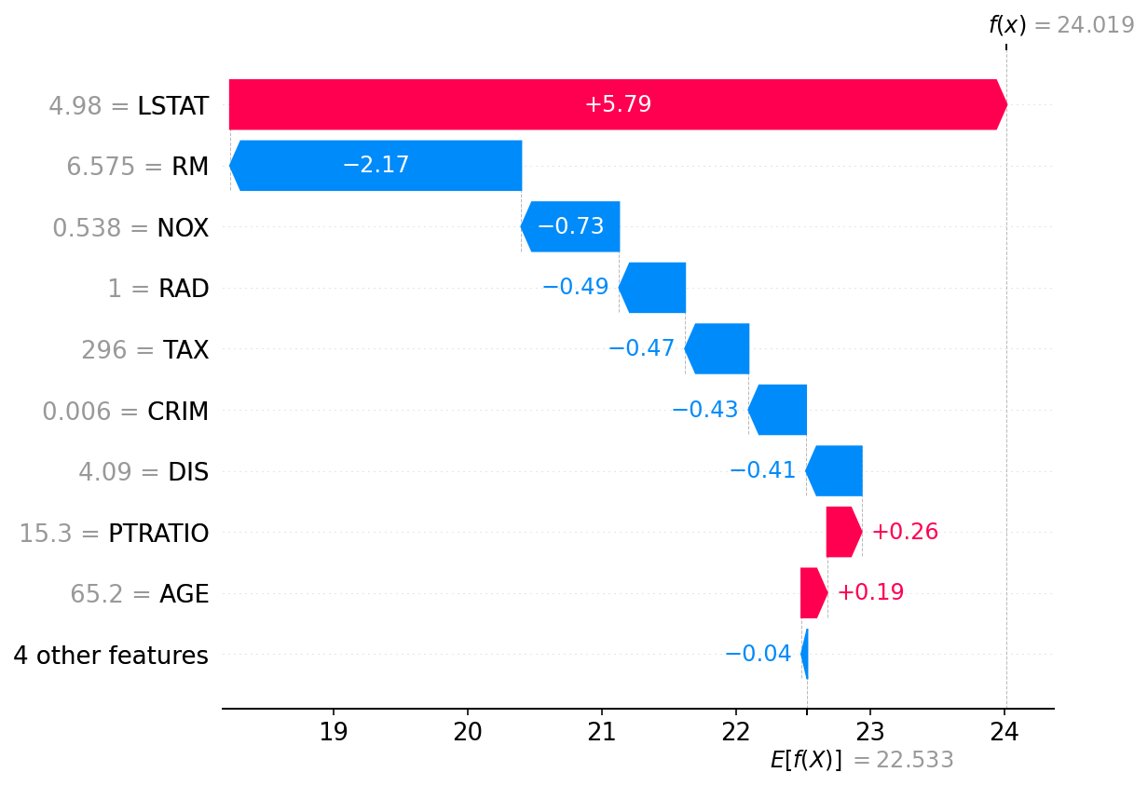
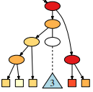
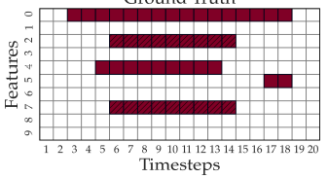
Interpretability of Learned Models
Model interpretability is becoming increasingly important as many high-impact domains require a better understanding of how the outputs are determined.
There is a wide variety in what model interpretability can entail. Different domains, tasks, and inputs require different levels of investigation.
Lundberg, Lee (2017), NIPS
Lee, Sood, Craven (2019), AAAI
Sood, Craven (2022), AAAI

Slide 3
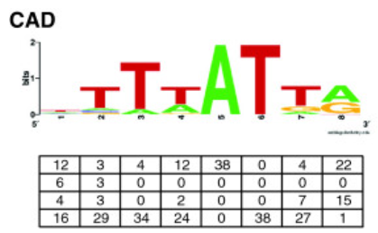
Interpretability for Genomic Sequences
Genomics research is one area where black-box models have shown state of the art results. However, the data use to create these models are not compatible with existing model interpretability methods.
Genomic sequences are similar to temporal sequences but offer unique challenges.
Features of interest often include motifs, which are subsequences that adhere to a position weight matrix.
Stringham et al., (2013). BMC

Slide 4
Goal of this work
Given an input of labeled genomic sequences and a model trained on this data we hope to:
Identify motifs within a sequence that are important to the model’s predictions
Identify the importance of the relationships between these motifs, such as the:
Interaction between motifs
Ordering of motifs
Distance between the motifs

Slide 5

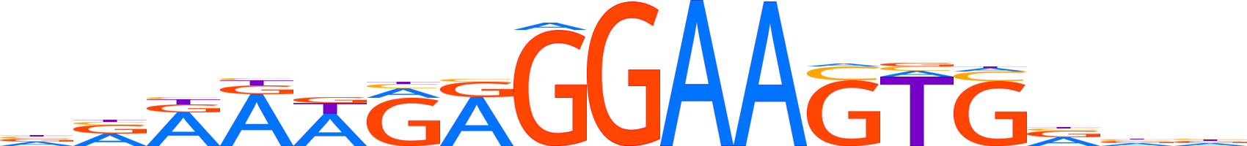
Approach for Feature Detection
Perturb
Data
Calculate Loss
Determine Significance
Required Inputs
Sequence | TGAGAGGAAGTC
Label | 1
Motif Positions | SPI1: 21, CFCT: 106
Sequence | TGAGAGGAAGTC
Label | 1
Motif Positions | SPI1: 21, CFCT: 106
Sequence | TGAGAGGAAGTC
Label | 1
Motif Positions | SPI1: 21, CFCT: 106
Original:
TGACTGAGGTGCATT
Wilcoxon:
Original – Perturbed
Trained Model
Perturbed:
TGATTGTACTGCATT

Slide 6

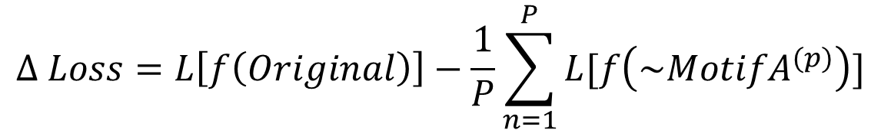
Importance of Single Motif
Original Sequence
TGCTGAGGAACTGTAACGACTTGGCGAAACCGT
A
Perturb
TGTTGGATTCATGTAACGACTTGGCGAAACCGT
x P
~ Motif A
$$∆ Loss=L\left[f\left(Original\right)\right]−\frac{1}{P}\sum_{n=1}^{P}{L[f\left({\sim MotifA}^{(p)}\right)]}$$
Calculate Loss

Slide 7

Interaction between Motifs
Original Sequence
TGCTGAGGAACTGTAACGACTTGGCGAAACCGT
A
B
Perturb
~ Motif A
TGTTGGATTCATGTAACGACTTGGCGAAACCGT
~ Motif B
TGCTGAGGAACTGTAACGACTTGGCGAAACCGT
~ Motifs A&B
TGGGAACTCAGTGTAACGACTTGGCTAAGCCGT
Calculate Loss
$$∆ Loss=L\left[f\left(g(\sim Motifs A\&B)\right)\right]−$$
$L\left[f(g\left(original\right)+∆g\left(\sim MotifA\right)+∆g\left(\sim MotifB\right)\right)$]

Slide 8
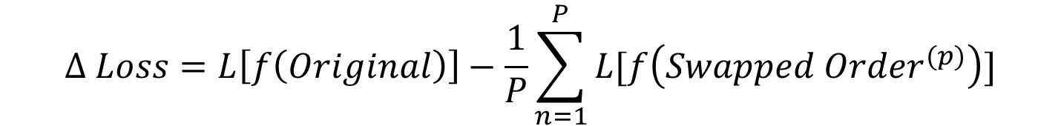
Order of Motifs
Original Sequence
TGCTGAGGAACTGTAACGACTTGGCGAAACCGT
First
Second
Perturb
Swap Order
TGCTGAGGTGTAACGACTTGGC GAA GT
Second
First
$$∆ Loss=L\left[f\left(Original\right)\right]−\frac{1}{P}\sum_{n=1}^{P}{L[f\left({Swapped Order}^{(p)}\right)]}$$
Calculate Loss

Slide 9
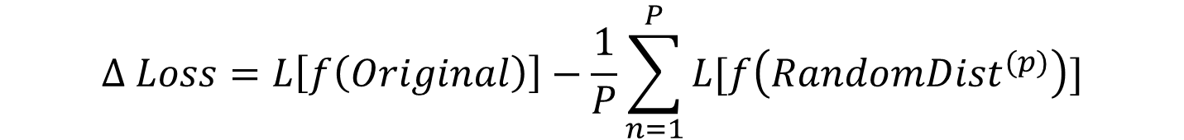
Distance between Motifs
Original Sequence
TGCTGAGGAACTGTAACGACTTGGCGAAACCGT
x < dist < y
Perturb
Randomize Distance
x P
TGTGTCTGAGGAACAACGACGAAACCTTGGCGT
$$∆ Loss=L\left[f\left(Original\right)\right]−\frac{1}{P}\sum_{n=1}^{P}{L[f\left({RandomDist}^{(p)}\right)]}$$
Calculate Loss

Slide 10
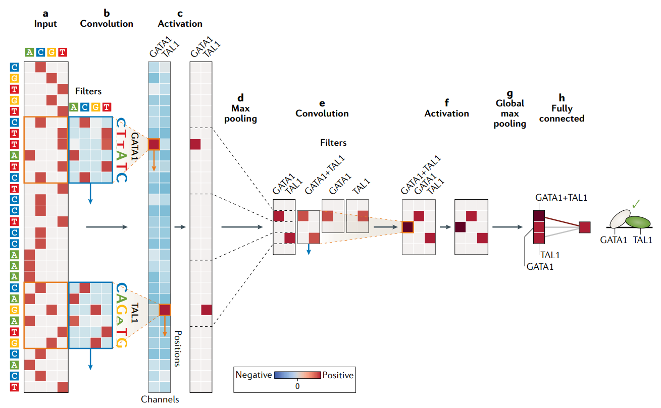
Evaluation
Created configurations of synthetic sequences using SimDNA packages
Trained CNNs on synthetic data
Accuracies above 93%
AUCs above 97%
Performed perturbation tests to assess feature importance
Eraslan et al. (2019). Nat Rev Genet

Slide 11

Configurations: Relevant Motifs
Configuration P: Single Relevant Motif
Details
Positive class based on presence of single motif
Additional motifs can be present
TGACTGAGGAAClTGTTTGGCGAAACCGGTG
Configuration M: Multiple Relevant Motifs
Details:
Positive class based on presence of all primary motifs
Additional motifs can be present
Order of motifs can vary
Distance between motifs can vary
TGCTGAGGAACTGTAACGACTTGGCGAAACCGT

Slide 12
Configurations: Relationships
Configuration O: Ordered Motifs
Details
Positive class based on presence of both motifs in specified order
Additional motifs can be present
Distance between motifs can vary
TGACTGAGGAAClTGTTTGGCGAAACCGGTG
First
Second
Configuration D: Distance Motifs
Details
Positive class based on presence of both motifs within specified distance
Additional motifs can be present
Order is also specified
TGACTGAGGAAClTGTTTGGCGAAACCGGTG
x < dist < y

Slide 13
Results

Slide 14
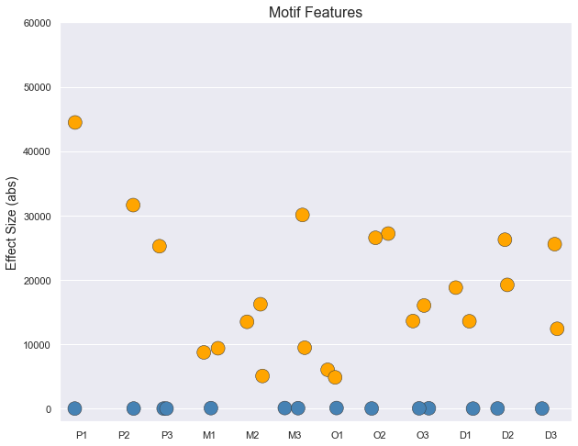
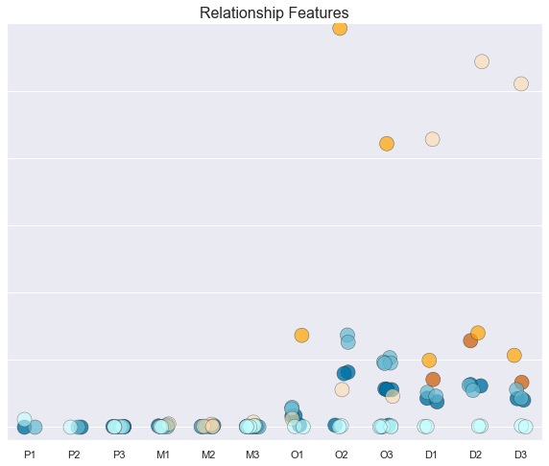
Overall Effect Size
Relevant
Non-Relevant
Interaction
Order
Distance
Relevant
Non-Relevant
Interaction
Order
Distance
Single Motif
Multiple Motifs
Ordered Motifs
Distance Motifs
Single Motif
Multiple Motifs
Ordered Motifs
Distance Motifs
Configurations

Slide 15
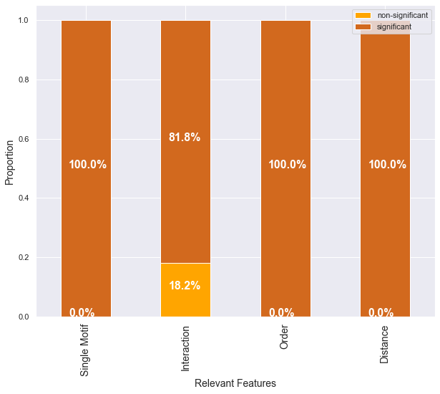
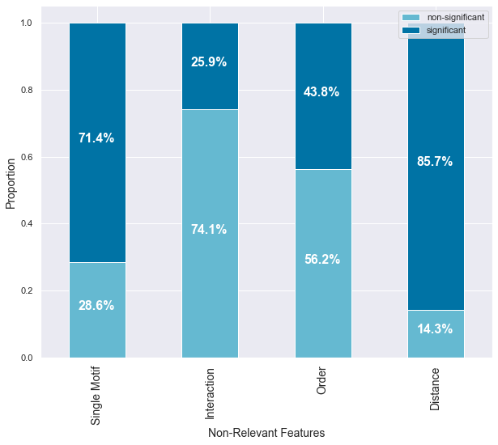
Significance Testing

Slide 16
Detailed Example
Distance Config: IRF & CTCF within 20-30 bases, (SPI1 also can be present)
Features | Effect Size | P-Value
CTCF/IRF interaction | -54319.73 | 0.0000
IRF | -26241.39 | 0.0000
CTCF | -19224.66 | 0.0000
CTCF/IRF order | -13970.61 | 0.0000
CTCF/IRF distance | -12823.83 | 0.0000
SPI1/IRF distance | -6297.87 | 0.0000
SPI1/IRF order | -6188.39 | 0.0000
SPI1/CTCF distance | -6106.74 | 0.0000
SPI1/CTCF order | -5435.62 | 0.0000
SPI1/IRF interaction | -126.01 | 0.1338
SPI1/CTCF interaction | -115.25 | 0.6154
SPI1 | 26.65 | 0.0347
Top features are all relevant motifs and relationships
SPI1 is has a positive effect size
Significant non-relevant motifs and relationship can suggest overfitting

Slide 17
Conclusion
Using the method outlined, we are able to detect relevant motifs in genomic sequences and relationships between them.
This method shows a tendency towards high false discovery rate, especially for motif importance and distance relationships.
A hierarchy which dictates when relationship features are assessed could protect against non-relevant relationships showing up as significant.

Slide 18
Future Work
Test on real world data and models to compare performance.
Add false discovery rate control methodology.
Improve the distance test to detect the window at which the relationship is relevant.
Extend work to include non-motif features that can appear in genomic sequences.
Incorporate motif discovery algorithm into the process

Slide 19
Questions?

Slide 20
References
Eraslan, G., Avsec, Ž., Gagneur, J. et al. (2019). Deep learning: new computational modelling techniques for genomics. Nat Rev Genet 20, 389–403. https://doi.org/10.1038/s41576-019-0122-6
Stringham, Jessica & Brown, Adam & Drewell, Robert & Dresch, Jacqueline. (2013). Flanking sequence context-dependent transcription factor binding in early Drosophila development. BMC bioinformatics. 14. 298. 10.1186/1471-2105-14-298.

Slide 21

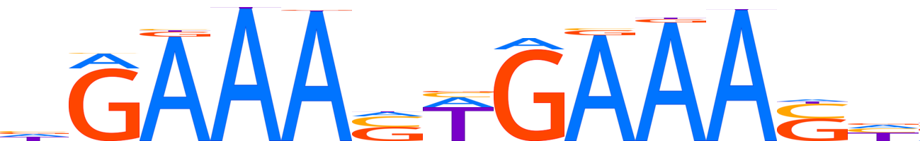

SPI1
CTCF
IRF
STAT
Notes:
For this work we used known motifs as the subsequences in our model. These are the four motifs that are used in the various test configurations for our this method. In the rest of my presentation I will talk about applying this method to motifs, but we expect our methods would work on other types of subsequences as well.

